Slide 1
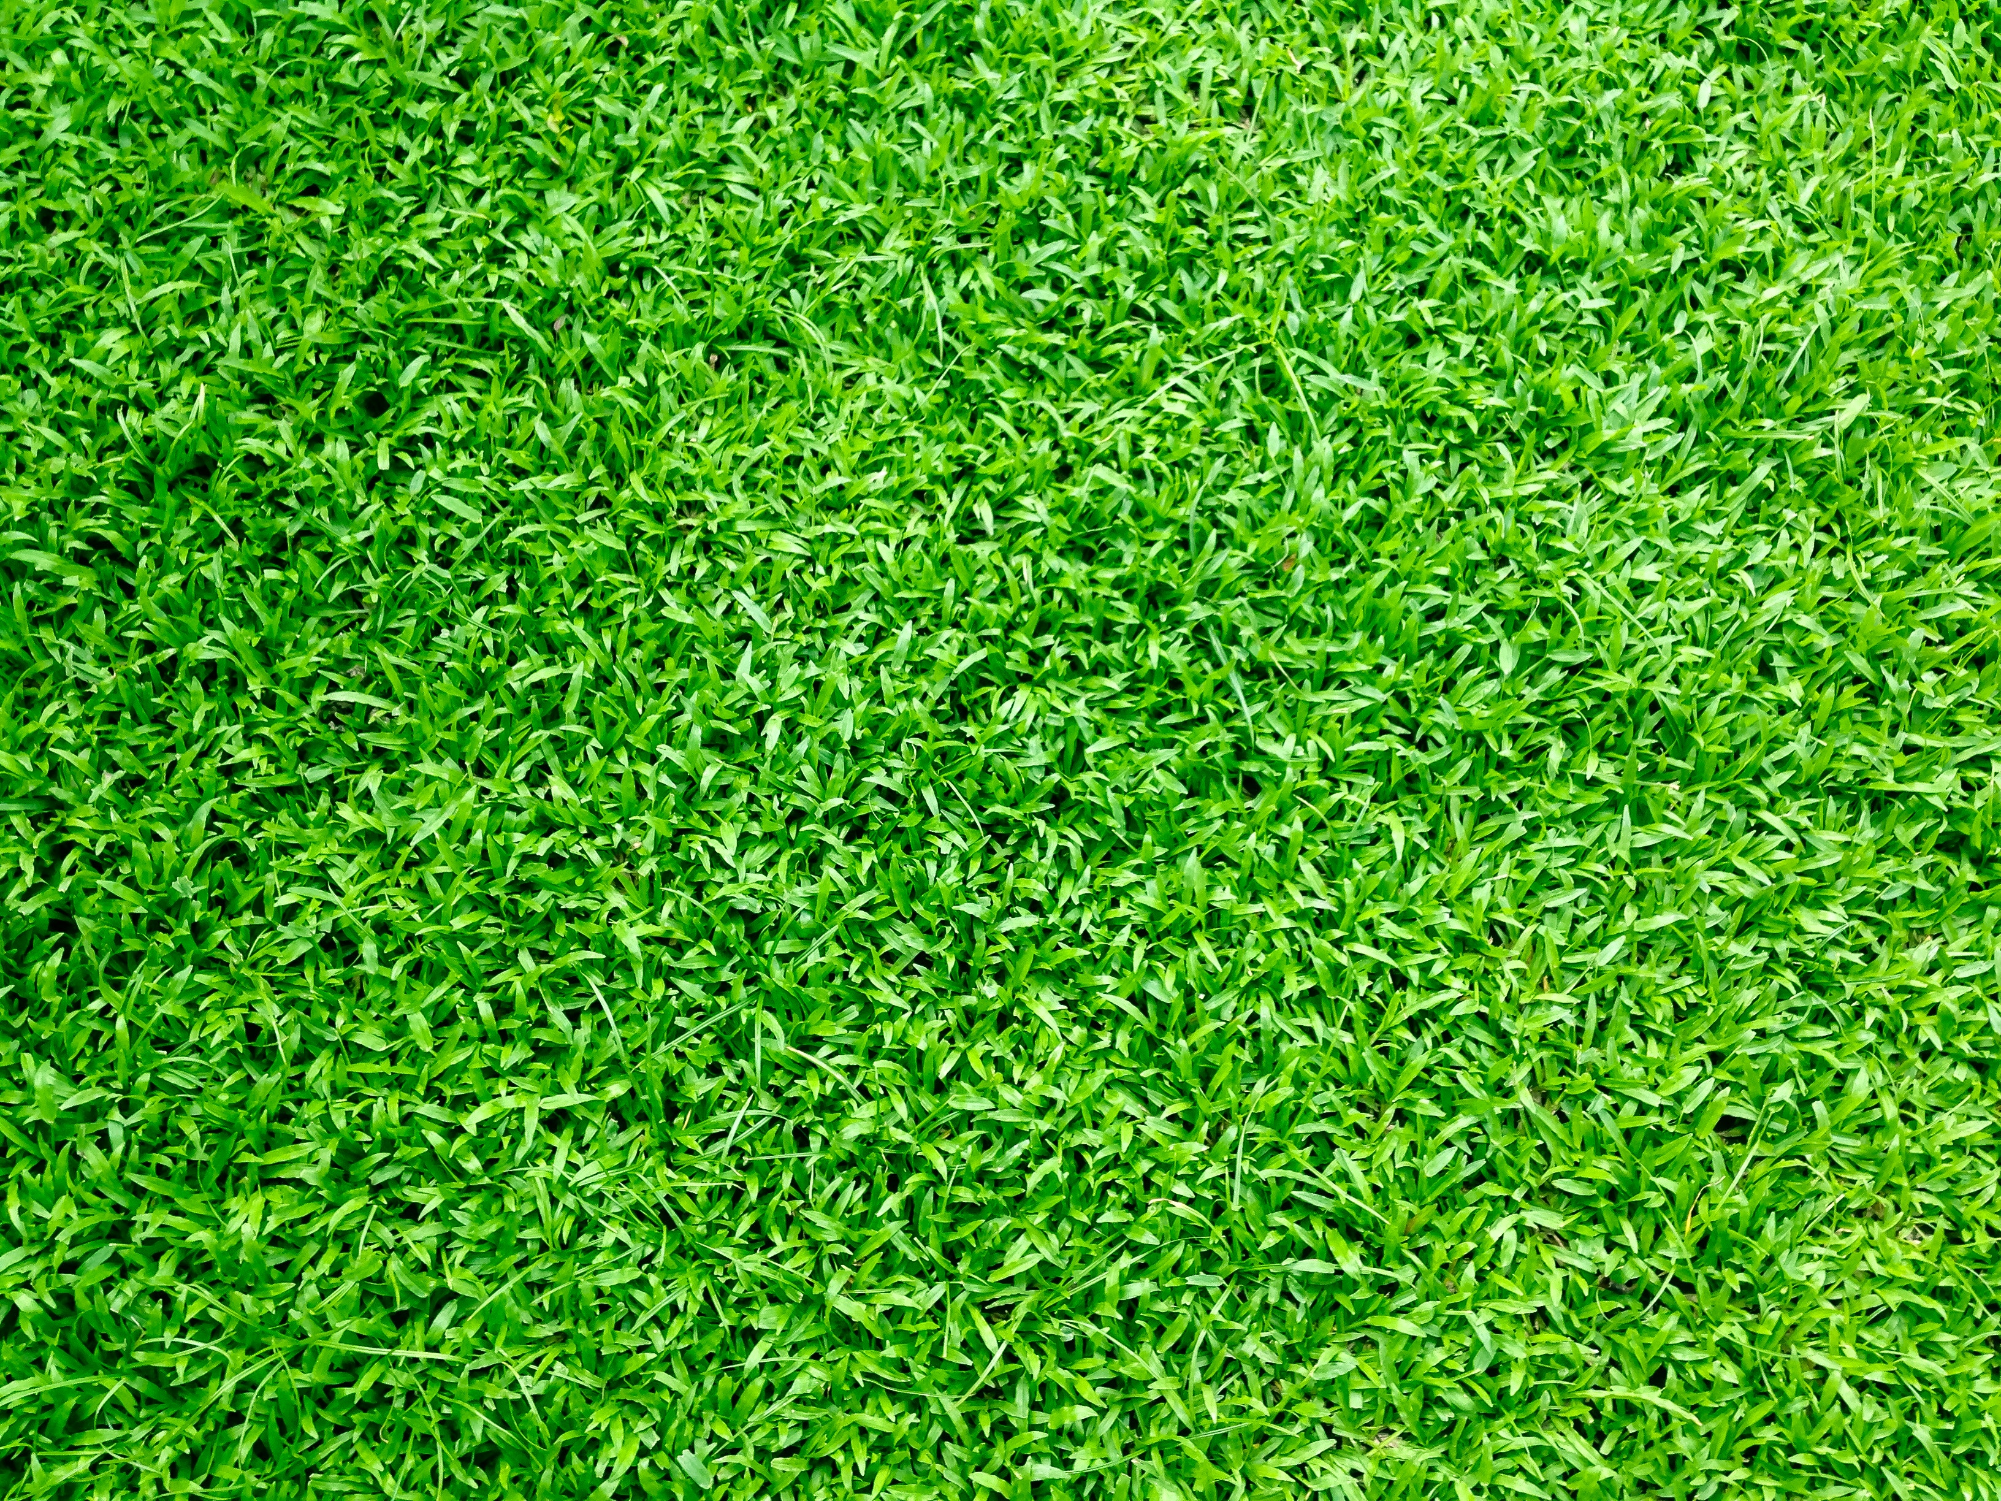
In our documentation we trust !
Source: https://www.pexels.com

Slide 2
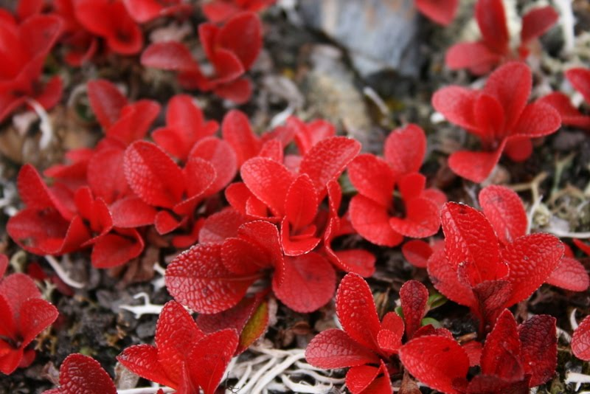
Gérald Reinhart Dev, EM, PO de theGardener
Source: G. Reinhart

Slide 3
Specification Fonctionelle
Specification Technique
Implementation
Cycle en cascade
Recette
Source: https://www.pexels.com
Source: https://thegardener.kelkoogroup.com

Slide 4

Source: https://pixabay.com

Slide 5
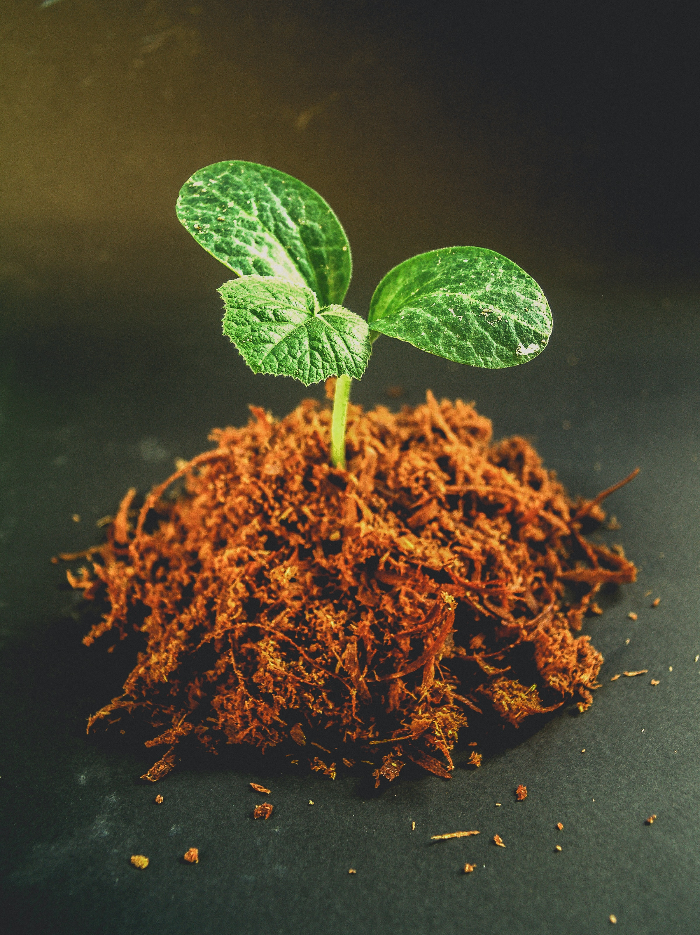
Kelkoo...
Source: https://www.pexels.com

Slide 6
Specification Fonctionelle
Implementation
À l’arache, en mode start up...
Source: https://www.pexels.com
Source: https://thegardener.kelkoogroup.com

Slide 7

Source: https://www.pexels.com

Slide 8
Specification
Documentation
Recette
Développement
Début de l’agilité
Source: https://www.pexels.com
Source: https://thegardener.kelkoogroup.com

Slide 9
Specification
Merge
Test
Documentation
Revue de code
Implémentation
Refactoring
Adoption des tests
Source: https://www.pexels.com
Source: https://thegardener.kelkoogroup.com

Slide 10

Wiki, Confluence, Backlog...
Source: https://www.pexels.com

Slide 11
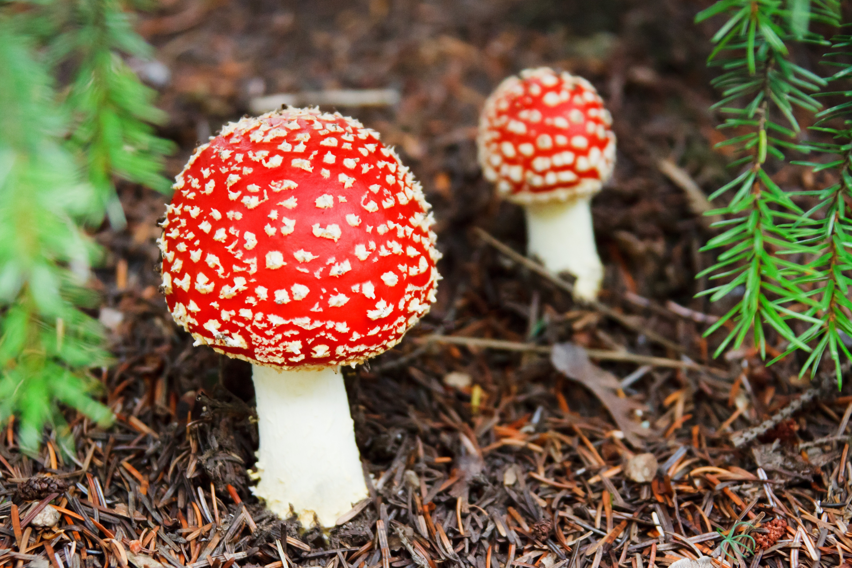
KO
OK
Source: https://www.pexels.com

Slide 12

BDD: Behavior Driven Development
Source: https://www.pexels.com

Slide 13
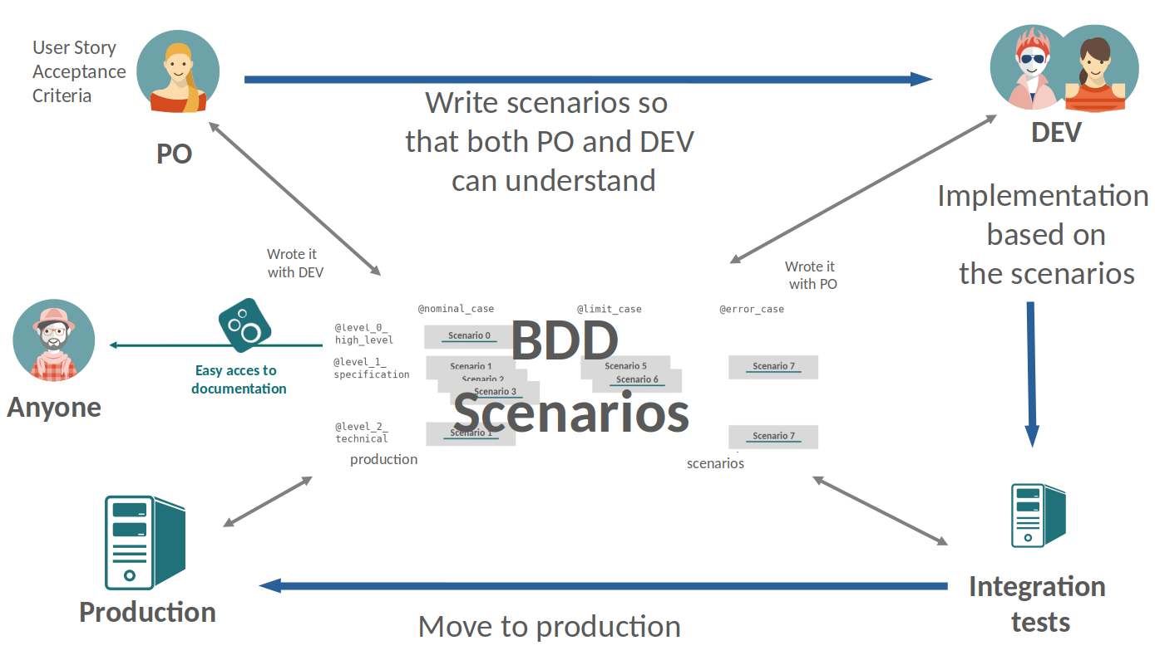
Source: https://thegardener.kelkoogroup.com

Slide 14

Source: https://pixabay.com

Slide 15

Source: https://pixabay.com

Slide 16

Source: https://thegardener.kelkoogroup.com

Slide 17
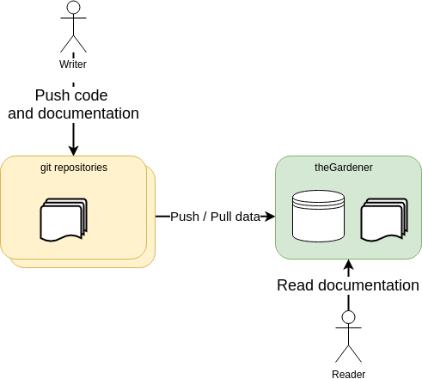
Source: https://www.pexels.com
Source: https://thegardener.kelkoogroup.com

Slide 18
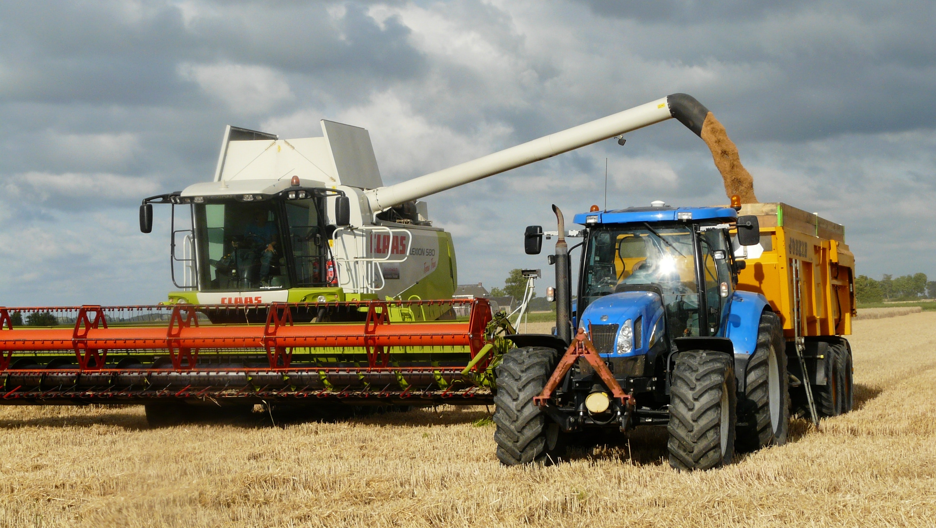
Source: https://www.pexels.com
Source: https://www.pexels.com

Slide 19
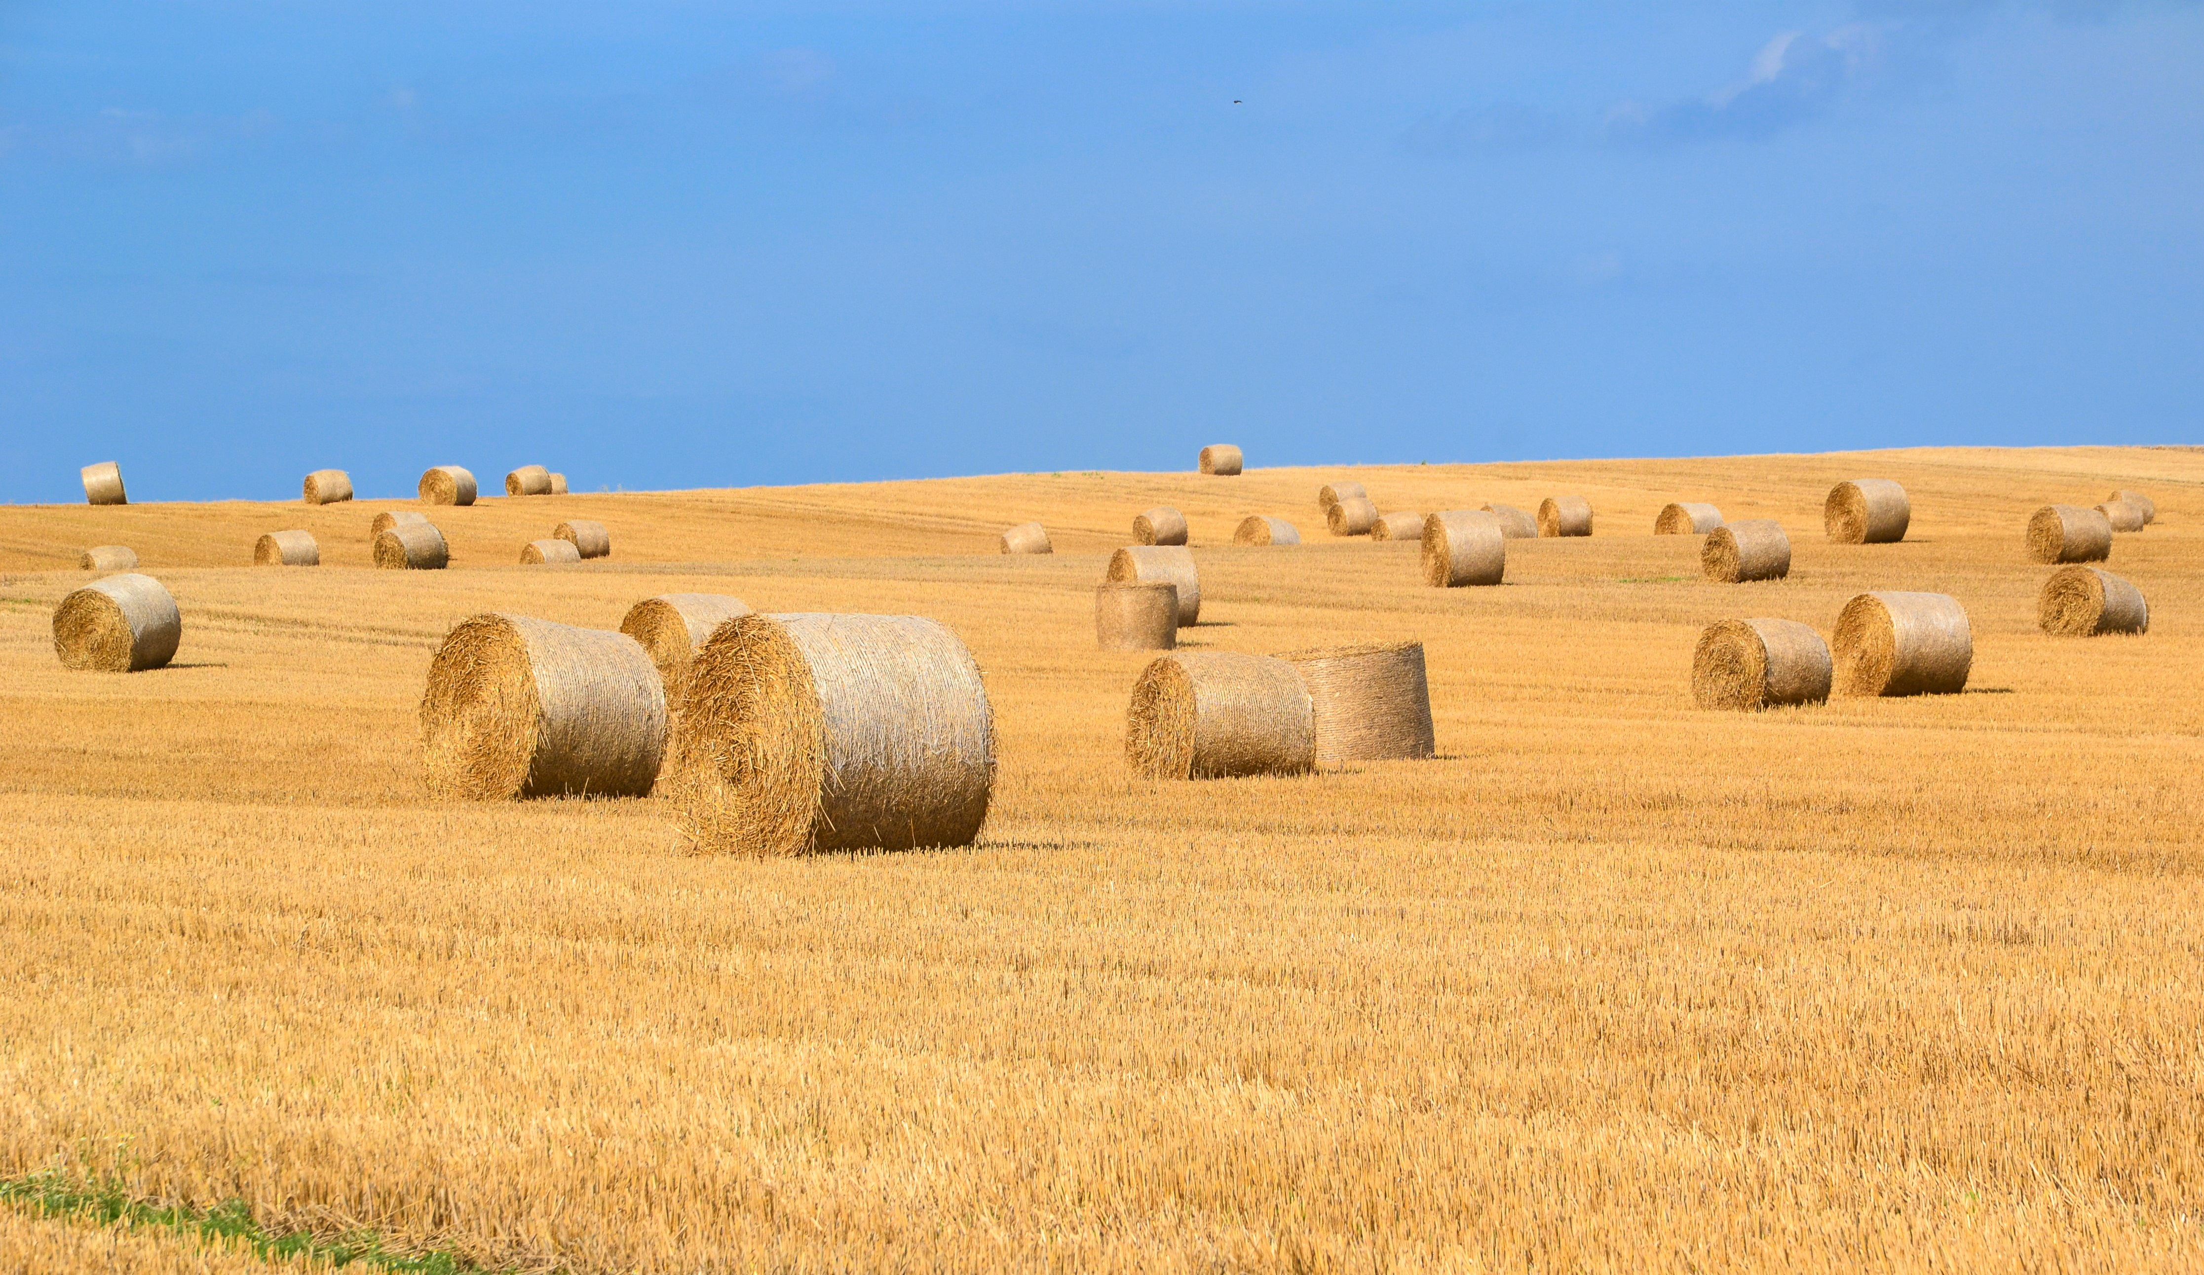
Source: https://www.pexels.com
Source: https://www.pexels.com

Slide 20

Guidé
Inclue dans le cycle de dev
Source: https://www.pexels.com

Slide 21
Specification
Merge
Test
Implémentation
Revue de code
Documentation
Refactoring
Inclusion de la documentation dans le cycle de dev
Source: https://www.pexels.com
Source: https://thegardener.kelkoogroup.com

Slide 22
Guide de documentation - Quoi
- Niveau platforme
- Niveau projet
- Niveau feature
- Qui
- Quand
- Comment - A qui
Source: https://www.pexels.com
Source: https://thegardener.kelkoogroup.com

Slide 23
Lignes directrices
Source: https://www.pexels.com
Source: https://thegardener.kelkoogroup.com

Slide 24

Documentation Trust Agreement
Source: https://www.pexels.com

Slide 25
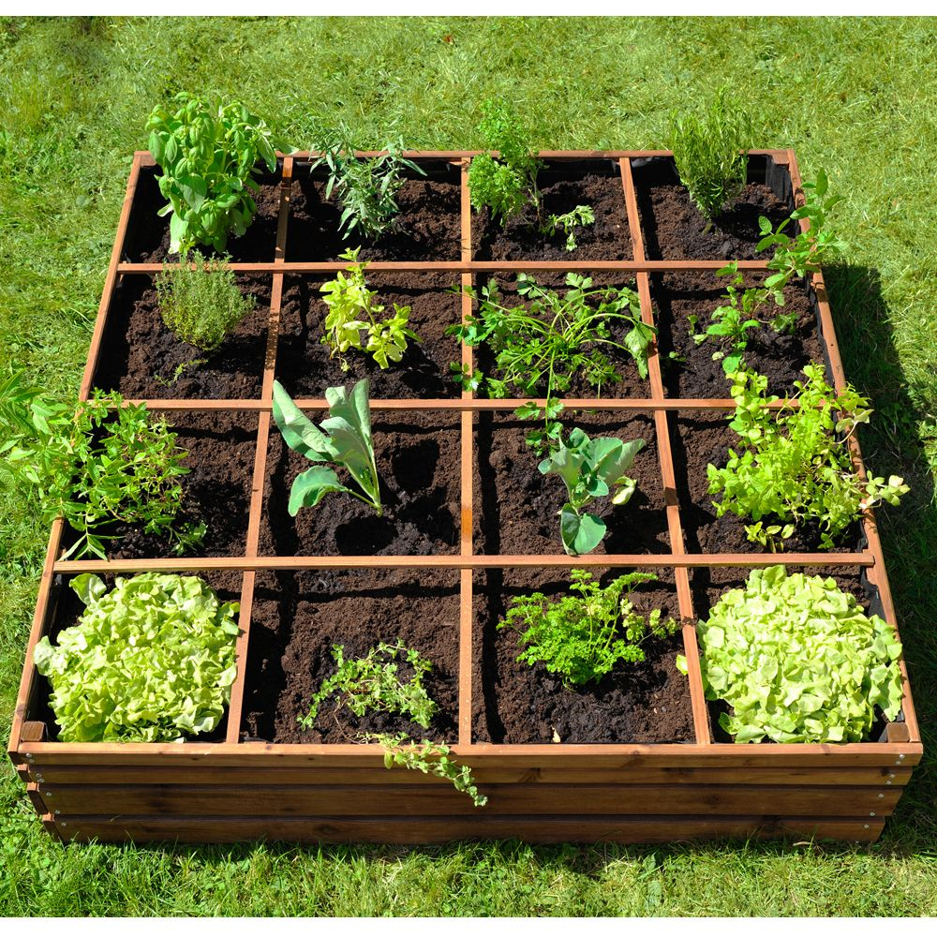
Source: https://www.pexels.com

Slide 26

Source: https://www.pexels.com
Source: https://www.pexels.com

Slide 27
Source: https://www.pexels.com

